Slide 1
BIOMEDIN 215 Data Science in Medicine
Nigam Shah, MBBS, PhD
nigam@stanford.edu

Slide 2
Recap: Health care databases
Are the data usable?
How are the data organized? (data model, or schema)
Where do the data come from? (provenance)
How can they be accessed? (usability)
Where are the errors introduced? (quality)
Are the data useful for me?
Are the exposures and outcomes recorded?
Are the variables that affect them recorded?
Are there enough data for events of interest?
Are there good correlates of 1 and 2?
Notes:
adapted from: https://academic.oup.com/jamia/article-abstract/doi/10.1093/jamia/ocx095/4108095/A-conceptual-framework-for-evaluating-data?redirectedFrom=fulltext
Sample size / rare events
I was a little confused about the slide regarding whether there is enough data to capture rare events. I'm mostly struggling with the concept of "person-years" and how that is related to rare events.
The last part on whether there is enough data was a little unclear. At the high level, I understand that if a condition is more prevalent, it is easier to detect with a small amount of data. I didn't quite understand the graph itself
what is the significance of using person years on our axes? How is relative risk calculated?
The Rare Events slide was a little confusing. I think in summary it's saying that we need obscene amounts of data to do analysis on rare events.
Bias
How to detect different biases (that are not as obvious as missing data bias) in a dataset?
The least clear part of today's lecture was the usage of random misclassification to the observed outcome measurement. I am unsure of the details regarding how you would do this and the overall efficacy of using this procedure to deal with misclassification bias. [share Vioxx-Heart attack example, from J. Biomedical Semantics]
I didn't quite follow the explanation of how to deal with misclassification bias it might just be something that I have to physically do to understand
I understand that the data environment is complex and subject to bias, but I am less clear about what parts of this reality we focus on for the purposes of this class.
Database
Is there any objective measure for general quality of healthcare databases, especially one created by a third party, given that the vast availability of such databases? What axes would such a quality metric consider? [Not yet. Superb research project for a PhD!]
How big of an issue is the situation like that described with redefining the diagnosis for pneumonia. Is testing for this a standard of practice anytime we want to use a dataset? [Wound Healing lecture]
Least clear was how to know what data, like the individual data entry categories are included in each dataset.
It'd be interesting to see a research example of combining/joining different sources of data [Casey’s paper]

Slide 3
Knowledge graphs in health care
What’s a knowledge graph?
What do I use it for?
Where do I get one?
Which should I use if I have a choice?

Slide 4
Knowledge graphs are everywhere!
May 2012, the Knowledge Graph was 500 million entities, and 3.5 billion facts.
October 2016, the Knowledge Graph held over 70 billion facts and answered "roughly one-third" of the searches
May 2020, this had grown to 500 billion facts on 5 billion entities

Slide 5
Things, names, relationship
concept ID | term or synonym
1 | t2d
1 | type 2 diabetes
2 | lumbago
2 | back pain
… | …
462 | metabolic disease
… | …
concept ID | meaning
1 | metabolic disease characterized by…
2 | chronic condition of…
… | …
concept ID 1 | relationship ID | concept ID 2
1 | 22 (is a) | 462
… | … | …

Slide 6
BREAKOUT:
You’re looking through the diagnosis codes, problem lists, and clinical notes in a dataset with thousands of patients.
You want to find everyone who has diabetes, and don’t want to review thousands of charts, what do you do?
Discuss with your colleague the ways in which you might find those patients

Slide 7
A knowledge graph gets you:
A set of things, that are common between datasets (think ‘features’)
ICD9 250
A vocabulary (and names of those things)
ICD9 250 = {“t2dm”, “type 2 diabetes”…}
Statements about how the things relate
ICD9 250 is a kind of ‘disease of other endocrine glands’ (ICD9 249-259)
RX 6809 (metformin) ‘may treat’ ICD9 250.
Therefore, RX 6809 ‘may treat’ ICD9 249-259
Notes:
https://www.ncbi.nlm.nih.gov/pubmed/25863278

Slide 8
Knowledge Graphs to know
ICD 9, 10
CPT
ATC
RxNorm
LOINC
SNOMED
Notes:
Who makes these
what are they used for
how do they reflect their provenance
how detailed are they in terms of what concepts are in it, what kinds of terms/synonyms, what kinds of metadata/meaning, and what kinds of relationships

Slide 9

International Classification of Diseases (ICD)
things:
diseases, pregnancy related events, injury, external causes of injury, factors affecting health status, and inpatient medical procedures
relationships:
subclass-of
Notes:
maintained by the World Health Organization
created in 1893 to track mortality statistics

Slide 10
ICD10 takes it to a whole new level

Slide 11

Current Procedural Terminology
used for categorizing medical procedures and services
things:
procedures, services, procedure modifiers
relationships:
subclass-of, modifier-of
99024 “suture removal during global period”
Notes:
developed, maintained and trademarked (!) by the CPT Editorial Panel of the American Medical Association, since 1966
used for categorizing medical procedures and services
available via $80 book and/or licensing fees paid to AMA
Category II codes are used for quality metrics, have a billable charge amount of $0 …. so no incentive to code with them
A global period is a period of time starting with a surgical procedure and ending some period of time after the procedure. Many surgeries have a follow-up period during which charges for normal post-operative care are bundled into the global surgery fee (https://www.dol.gov/owcp/regs/compliance/GlobalSurgicalPolicy.pdf)

Slide 12
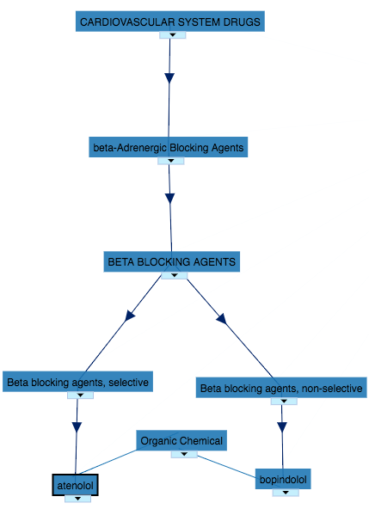
Anatomic Therapeutic Chemical (ATC) Classification system
V01AA10 - “flowers”
Various
Allergens
Allergens
Allergen extracts
Flowers
Categorizes the active ingredients of drugs by:
the organ system(s) they act upon,
their therapeutic, or
pharmacological properties
Notes:
Maintained by the WHO since 1976

Slide 13

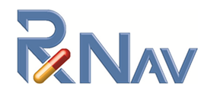
RxNorm and RxNav (by the NLM)
RxNorm = a normalized naming system for generic and branded drugs.
RxNav a tool to search
Notes:
RxNorm aggregates synonyms for drugs, assigns them a unique identifier, and links to information about that drug.
concepts:
drug, generic name, trade name, dosage, form, NDC code
relationships:
subclass-of; has-trade-name, has-dosage, etc.

Slide 14
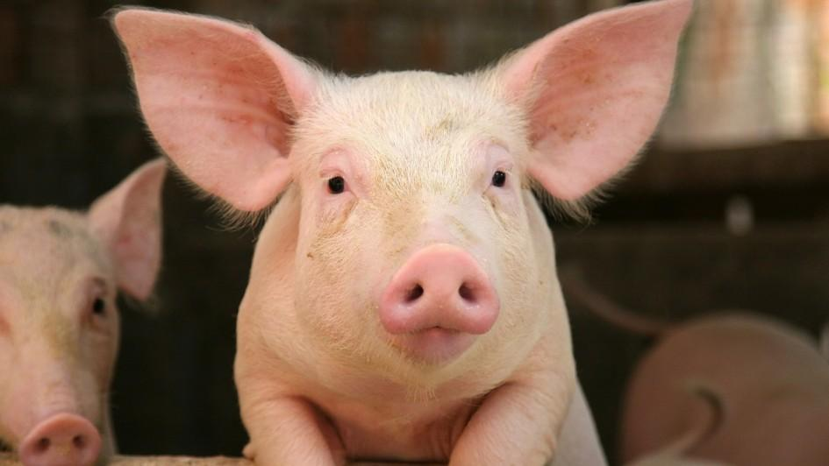
Logical Observation Identifiers Names and Codes (LOINC)
things:
measurement/ evaluation/ observation;
measurement properties: kind of measurement, time interval of measurement, system in which measurement was made, type of scale of measure, type of method of measure
relationships:
subclass-of, links between measurement and its properties
10952-0
“Swine urine proteins IgE Ab [Units/volume] in Serum”
Notes:
Developed and maintained by the Regenstrief Institute since 1994
categorizes and provides identifiers for medical laboratory observations

Slide 15
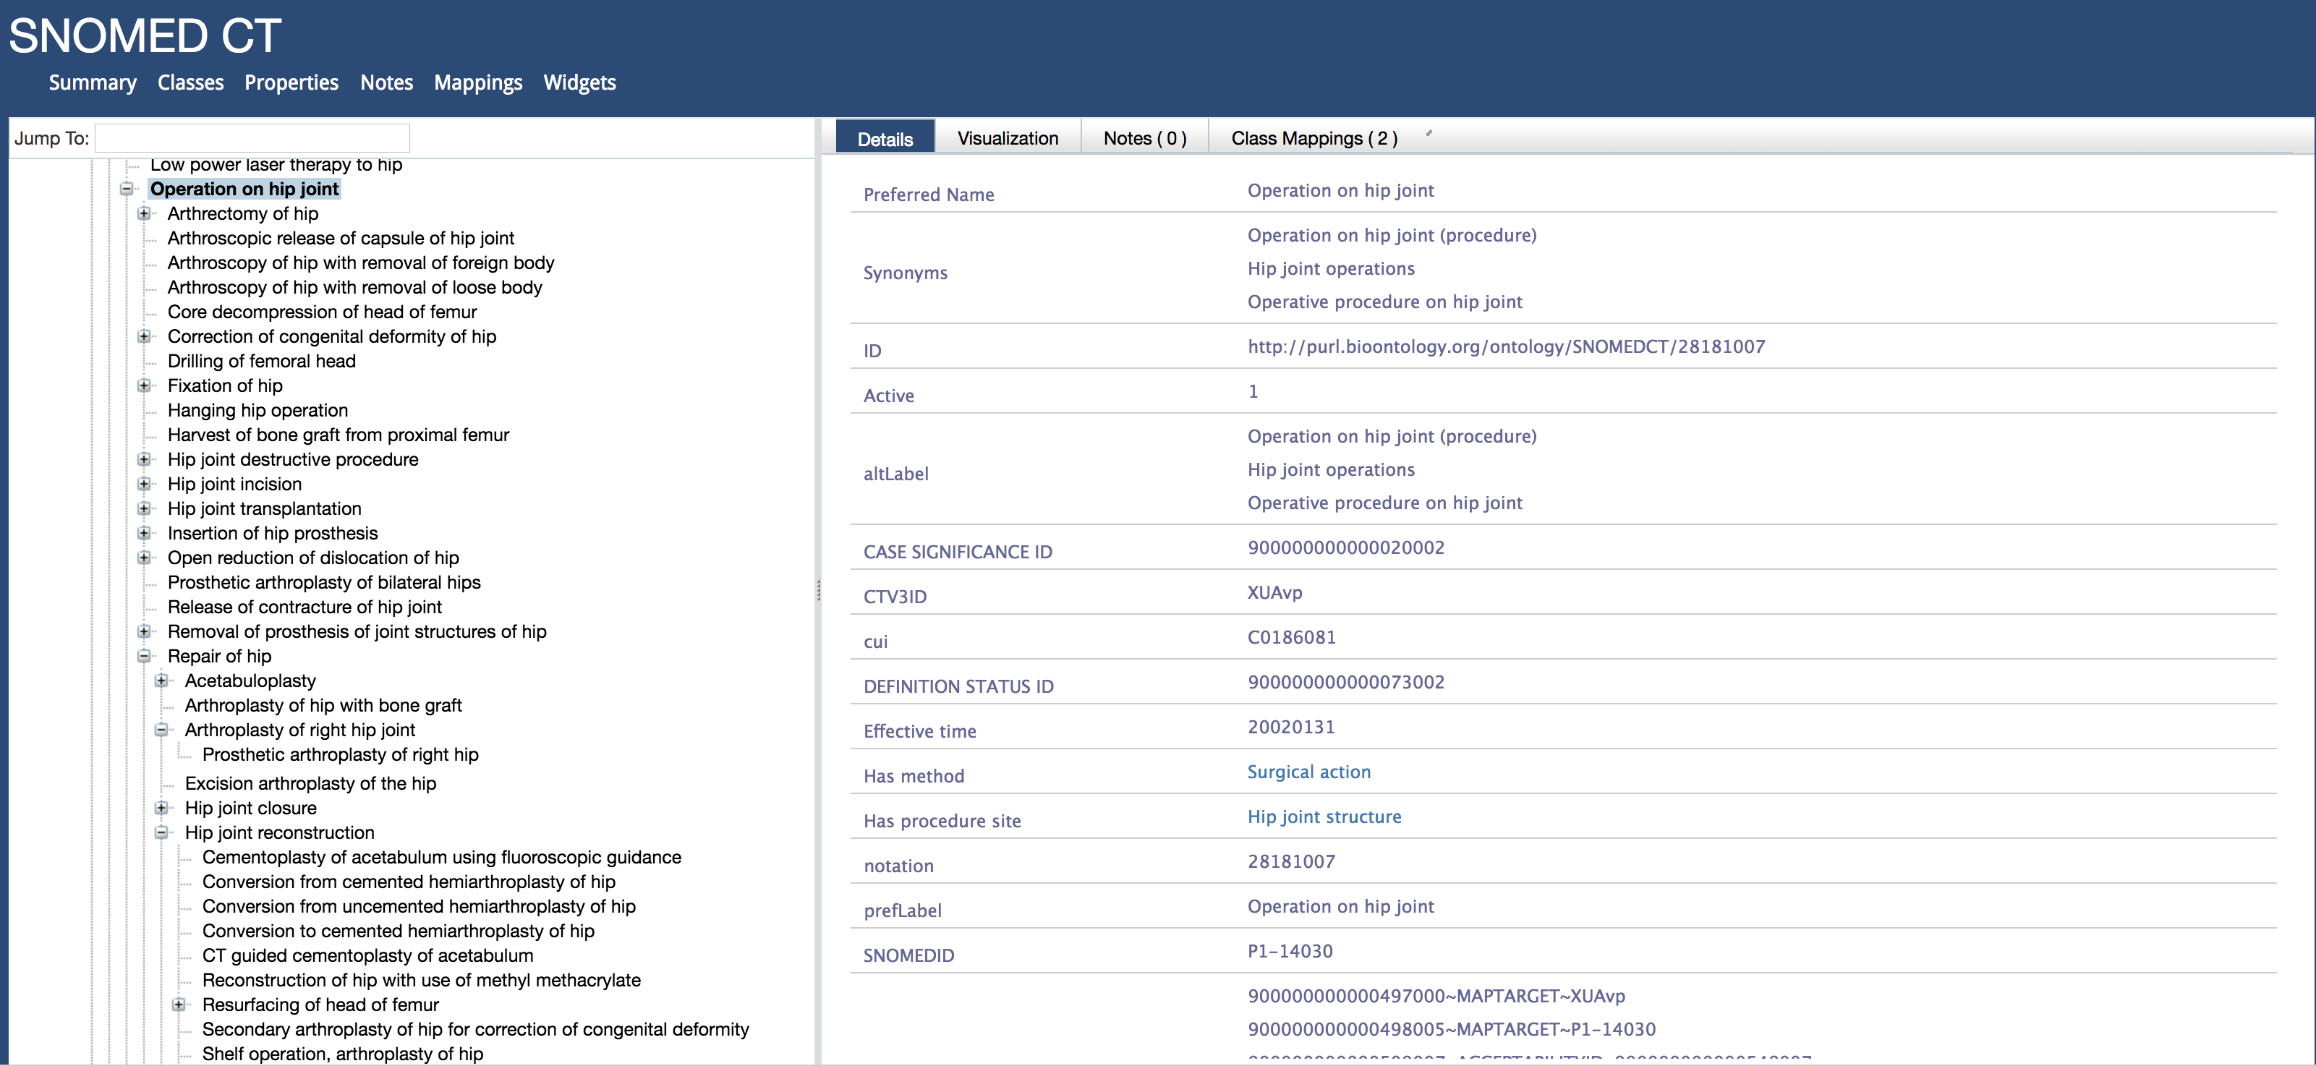
SNOMED CT - One graph to rule them all?

Slide 16
You just got hired as a chief data scientist at a health informatics company, and you are asked to figure out what drug treats what diseases.
Think of ways in which you might do that
Notes:
1. Query public databases for possible medications by their indication
2. Use a knowledge graph that captures this information in one place!
## The tradeoff is that you have to *trust* the source

Slide 17
The most important knowledge graph in medicine

Slide 18
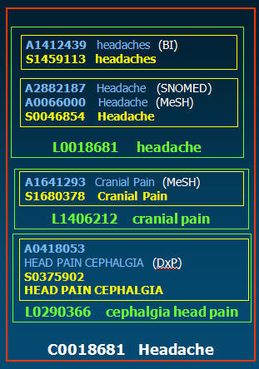
Metathesaurs: Identifiers
Concept Unique Identifiers (CUI) – 2,612,024
Lexical (term) Unique Identifiers (LUI) – 7,734,809
String Unique Identifiers (SUI) – 8,677,735
Atom Unique Identifiers (AUI) – 10,506,764
Notes:
Concept Unique Identifiers (CUI) A concept is a meaning. A meaning can have many different names. A key goal of Metathesaurus construction is to understand the intended meaning of each name in each source vocabulary and to link all the names from all of the source vocabularies that mean the same thing (the synonyms). CUI contain the letter C followed by seven numbers. In the example on the right the CUI is C0018681.
Lexical (term) Unique Identifiers (LUI) LUI link strings that are lexical variants. Lexical variants are detected using the Lexical Variant Generator (LVG) program, one of the UMLS lexical tools. LUI contain the letter L followed by seven numbers. In the example on the right there are three lexical variants, each given a seperate LUI.
String Unique Identifiers (SUI) Each unique concept name or string in each language in the Metathesaurus has a unique and permanent string identifier (SUI). Any variation in character set, upper-lower case, or punctuation difference is a separate string, with a separate SUI. SUI contain the letter S followed by seven numbers. In the example on the right there are four strings with four different SUI.
Atom Unique Identifiers (AUI) The basic building blocks or "atoms" from which the Metathesaurus is constructed are the concept names or strings from each of the source vocabularies. Every occurrence of a string in each source vocabulary is assigned a unique atom identifier (AUI). If exactly the same string appears multiple times in the same vocabulary, for example as an alternate name for different concepts, a unique AUI is assigned for each occurrence. AUI contain the letter A followed by seven numbers. In the example on the right there are five strings from five sources with five different AUI. The abbreviation for the source that contributed each string is noted in parentheses after the string.

Slide 19
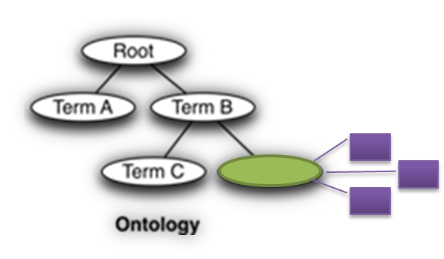
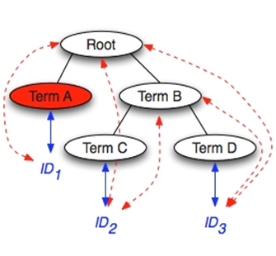
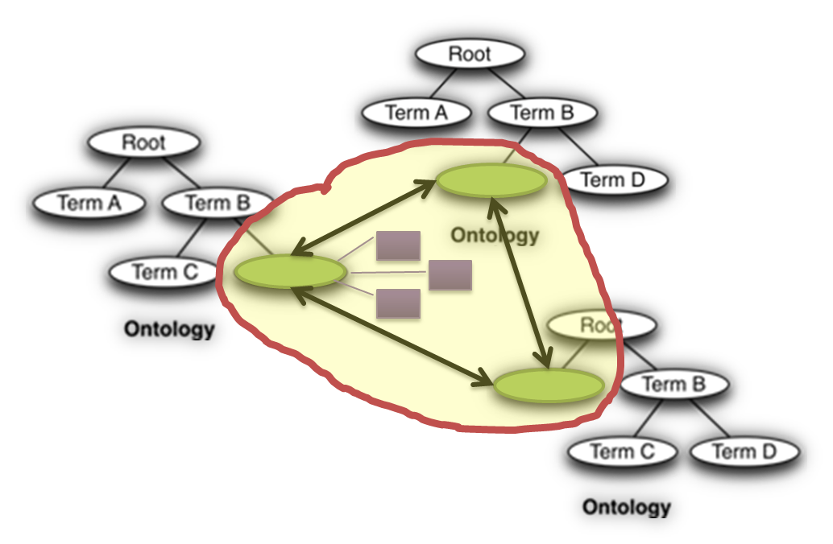
Metathesaurus: data files
File Name | Contents
MRCONSO | Names, Synonyms, Terms, Term Types, Codes
MRREL | Relationships
MRHIER | Hierarchies
MRSAT | Attributes
MRDEF | Definitions
MRMAP | Mappings
MRSMAP | Simplified Mappings
MRSTY | Semantic Types

Slide 20
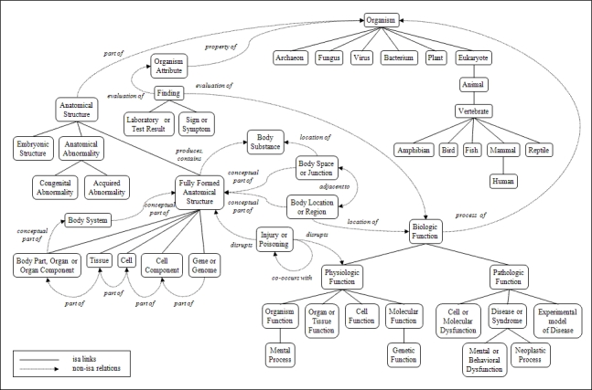
Semantic Network
Semantic types are broad categories, like Disease or Clinical Drug.
Semantic relationships exist between semantic types.
For example: Clinical Drug treats Disease or Syndrome

Slide 21
SPECIALIST Lexicon and Lexical Tools
Find out what these are by reviewing the assigned reading.

Slide 22
Using knowledge graphs
Notes:
Standardization ->ETL; integrating datasets
Vocabulary -> standardizing datasets, NLP
Using metadata to ensure quality/reproducibility – changes in GO over time
Relationships -> aggregation and reasoning

Slide 23
Finding things across datasets
Observational Health Data Sciences and Informatics (OHDSI) community
Uses a Common Data Model and Standard Vocabularies to structure and annotate health data, enabling shared tools, reusable methods and a growing data network.
https://youtu.be/2tTfxYlwCrg?si=Mk4Ri2Fh4HKjhpyB
https://www.ohdsi.org/join-the-journey/
Notes:
If we all use the same standard to talk about things, we can share results

Slide 24
Vocabulary: text mining, search
The need
Knowledge graph provides
A dictionary of terms
A way to organize terms and concepts as sets of related terms
e.g. synonyms, alternative labels
source of terms for things you care about.
mechanism to define the kinds (or types) of things you care about.
a declaration of what terms are interchangeably used.

Slide 25
Computations using relationships
Identifying what thing subsumes what other things (or how two things relate in general e.g. drug treats disease)
Selecting the right “level” in the hierarchy
Knowing alternative names for one identifier
Notes:
The tradeoff is that you have to *trust* the source

Slide 26
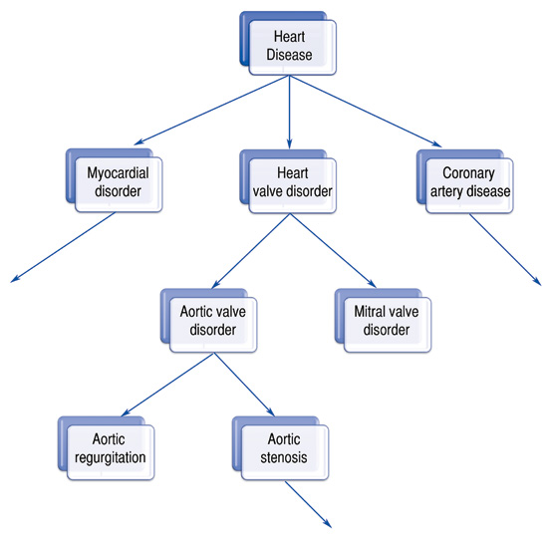
What thing subsumes what other things

Slide 27
Selecting the right “level”
Information content =
# of patients who have the concept or a descendant of the concept in their record
total # of patients

Slide 28
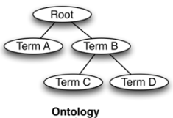
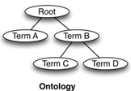
Knowing alternative names
tid | str | freq | suppress | source
46107 | hypoadrenalism | 89 | (null) | (null)
2662032 | hypoadrenalism (disorder) | 0 | (null) | (null)
909629 | hypoadrenalism with achalasia | 0 | (null) | (null)
869335 | hypoadrenalism, primary | 0 | (null) | (null)
869334 | hypoadrenalisms, primary | 0 | (null) | (null)
MedDRA
SNOMED CT
hypoadrenalism
syndrome
Addison’s disease
MeSH
tid | str | freq | suppress | source
36442 | addison disease | 180 | (null) | (null)
24680 | addison's disease | 511 | (null) | (null)
52232 | addisonian crisis | 61 | (null) | (null)
86884 | addisons disease | 10 | (null) | (null)
Adrenal insufficiency
tid | str | freq | suppress | source
8829 | adrenal insufficiency | 4861 | (null) | (null)
95136 | adrenal insufficiency, primary | 7 | (null) | (null)
138843 | adrenal gland insufficiency | 1 | TRUE | auto

Slide 29
Choosing a Knowledge Graph

Slide 30
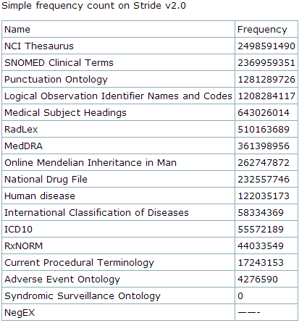
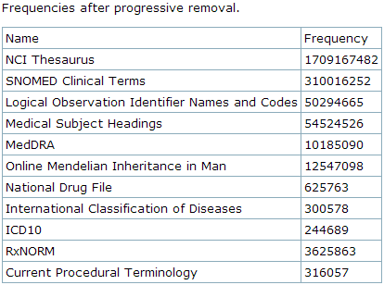
Which knowledge graph to use?

Slide 31
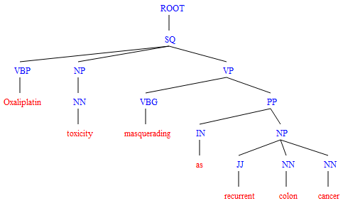
Which terms to keep?
Sentence in Clinical Note – 1
:
:
Sentence in Clinical Note – m
Sentence in Medline abstract – 1
:
:
Sentence in Medline abstract – n
Frequency
Syntactic types
Semantic types
IC filter
SYN filter
STY filter
Term – 1
:
:
Term – n
 |  | tf | df | NN | JJ | … | VP | T-1 | T-2 | T-3
ID | Term-1 | 150,879 | 90,000 | 0.90 | 0.05 | … | 0.03
ID | :
ID | Term-n
Notes:
Here each ‘Term-1’, ‘Term-n’ is a text string (name, preferred label or synonym) of a concept/class in BioPortal. There would be one ID/Code and multiple text-strings corresponding to that ID/Code
We create clean lexicons by using the term frequency and syntactic type information on individual terms in large corpora [1, 67, 68]. Since most biomedical concepts (90%) are noun phrases, removing those terms whose dominant syntactic types are not noun phrases, improves the quality of the lexicon [1, 68]. Furthermore, we use the ratio of term frequency to document frequency to prune out terms that have little value as features for data-mining, such as 'study', 'treatment', 'patients' or 'results.' By using the frequency information on terms, we reduce the size of the lexicon by 81% [1, 68]. Finally, based on Wu et al and McCray et al [1-3], for every entry in the dictionary, we assign one of four semantic groups (drug, disease, device, or procedure) and use the predominant semantic group for a given term to prune out ambiguous terms (e.g., in the EHR “clip” is most likely mentioned as a device and not as Corticotropin-Like Intermediate lobe Peptide substance). Such pruning removes 826,162 strings and 308,300 concepts from our dictionary—a 25% reduction, thus leveraging established ontology auditing methods [4-6].

Slide 32
Assigned reading
See Lecture-4 module on Canvas.
Lecture Review Quiz is up on Canvas

Slide 33
Where to look for knowledge graphs, concepts, and terms
http://bioportal.bioontology.org by Stanford
https://uts.nlm.nih.gov/home.html by NLM
http://rxnav.nlm.nih.gov/rxnav.jnlp by NLM
https://developers.google.com/knowledge-graph by Google
http://health-lifesci.schema.org/MedicalEntity by Schema.org
Notes:
Schema.org is a collaborative, community activity with a mission to create, maintain, and promote schemas for structured data on the Internet. In addition to people from the sponsoring companies (Google, Microsoft, Yahoo and Yandex), there is substantial participation by the larger Web community
- Show example of using bioportal e.g. to find all ace inhibitors

